Slide 1
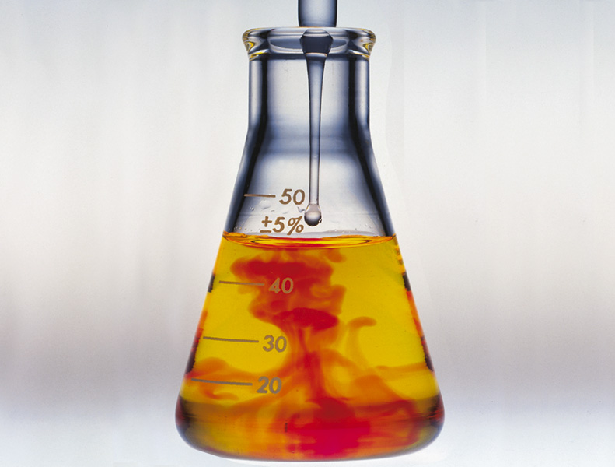
Chapter 18: Additional Aspects of
Acid-Base Equilibria
General Chemistry
Principles and Modern Applications
Petrucci • Harwood • Herring
8th Edition
Philip Dutton
University of Windsor, Canada
N9B 3P4
Prentice-Hall © 2002

Slide 2
Contents
18-1 The Common-Ion Effect in Acid-Base Equilibria
18-2 Buffer Solutions
18-3 Acid-Base Indicators
18-4 Neutralization Reactions and Titration Curves
18-5 Solutions of Salts of Polyprotic Acids
18-6 Acid-Base Equilibrium Calculations: A Summary
Focus On Buffers in Blood

Slide 3
18-1 The Common-Ion Effect in Acid-Base Equilibria
The Common-Ion Effect describes the effect on an equilibrium by a second substance that furnishes ions that can participate in that equilibrium.
The added ions are said to be common to the equilibrium.

Slide 4
Solutions of Weak Acids and Strong Acids
Consider a solution that contains both 0.100 M CH₃CO₂H and 0.100 M HCl.
CH₃CO₂H + H₂O  CH₃CO₂⁻ + H₃O⁺
(0.100-x) M x M x M
HCl + H₂O  Cl⁻ + H₃O⁺
0.100 M 0.100 M
[H₃O⁺] = (0.100 + x) M essentially all due to HCl

Slide 5
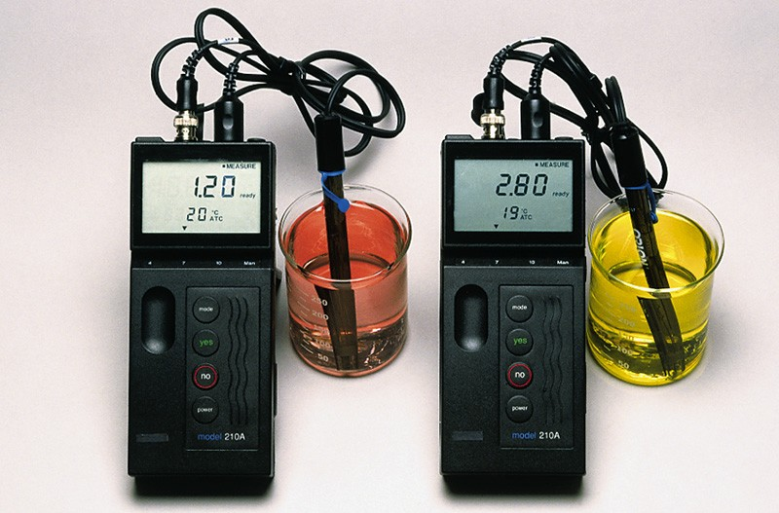
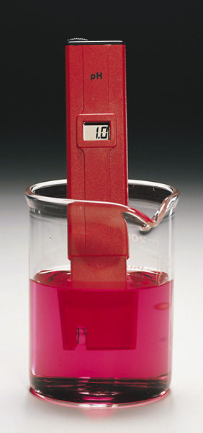
Acetic Acid and Hydrochloric Acid
0.1 M HCl
0.1 M CH₃CO₂H
0.1 M HCl +
0.1 M CH₃CO₂H

Slide 6
Example 18-1
Demonstrating the Common-Ion Effect:
A Solution of a weak Acid and a Strong Acid.
(a) Determine [H₃O⁺] and [CH₃CO₂⁻] in 0.100 M CH₃CO₂H.
(b) Then determine these same quantities in a solution that is 0.100 M in both CH₃CO₂H and HCl.
Recall Example 17-6 (p 680):
CH₃CO₂H + H₂O → H₃O⁺ + CH₃CO₂⁻
[H₃O⁺] = [CH₃CO₂⁻] = 1.310⁻³ M

Slide 7
Example 18-1
CH₃CO₂H + H₂O → H₃O⁺ + CH₃CO₂⁻
Initial concs.
weak acid 0.100 M 0 M 0 M
strong acid 0 M 0.100 M 0 M
Changes -x M +x M +x M
Eqlbrm conc. (0.100 - x) M (0.100 + x) M x M
Assume x << 0.100 M, 0.100 – x 0.100 + x  0.100 M

Slide 8
Example 18-1
CH₃CO₂H + H₂O → H₃O⁺ + CH₃CO₂⁻
Eqlbrm conc. (0.100 - x) M (0.100 + x) M x M
Assume x << 0.100 M, 0.100 – x 0.100 + x  0.100 M
[H₃O⁺] [CH₃CO₂⁻]
x · (0.100 + x)
K_{a}=
=
[C₃CO₂H]
(0.100 - x)
x · (0.100)
=
= 1.810⁻⁵
(0.100)
[CH₃CO₂⁻] = 1.810⁻⁵ M compared to 1.310⁻³ M.
Le Chatellier’s Principle

Slide 9
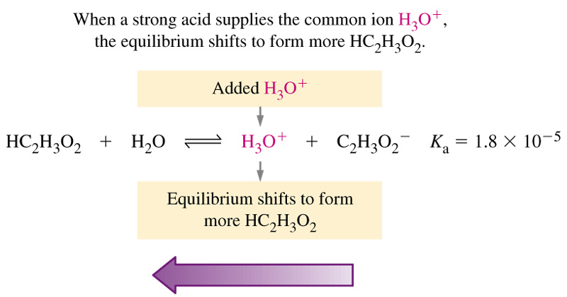
Suppression of Ionization of a Weak Acid

Slide 10
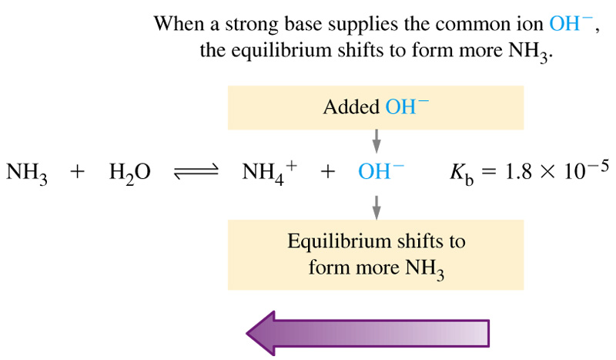
Suppression of Ionization of a Weak Base

Slide 11
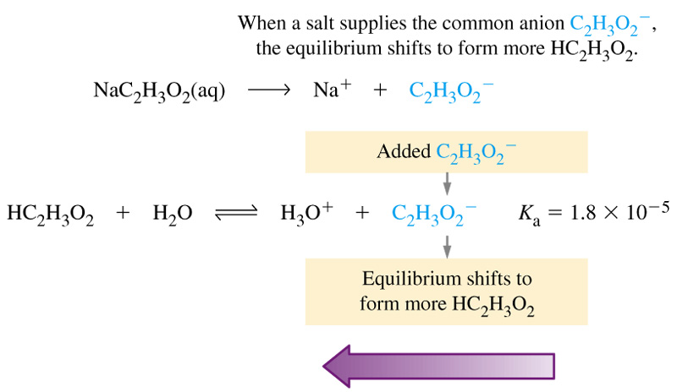
Solutions of Weak Acids and Their Salts

Slide 12
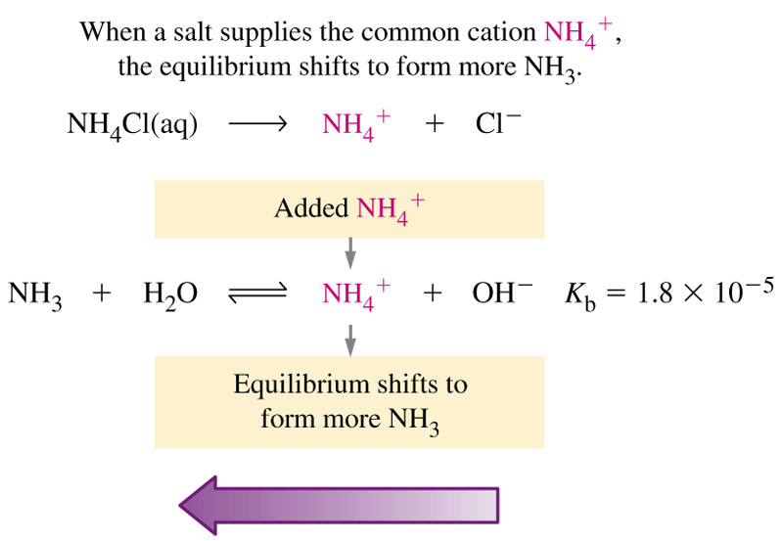
Solutions of Weak Bases and Their Salts

Slide 13
18-2 Buffer Solutions
Two component systems that change pH only slightly on addition of acid or base.
  The two components must not neutralize each other but must neutralize strong acids and bases.
A weak acid and it’s conjugate base.
A weak base and it’s conjugate acid

Slide 14
Buffer Solutions
Consider [CH₃CO₂H] = [CH₃CO₂⁻] in a solution.
[H₃O⁺] [CH₃CO₂⁻]
K_{a}=
=
1.810⁻⁵
[C₃CO₂H]
[CH₃CO₂⁻]
[H₃O⁺] =
K_{a}
=
1.810⁻⁵
[C₃CO₂H]
pH = -log[H₃O⁺] = -logK_{a} = -log(1.810⁻⁵) = 4.74

Slide 15
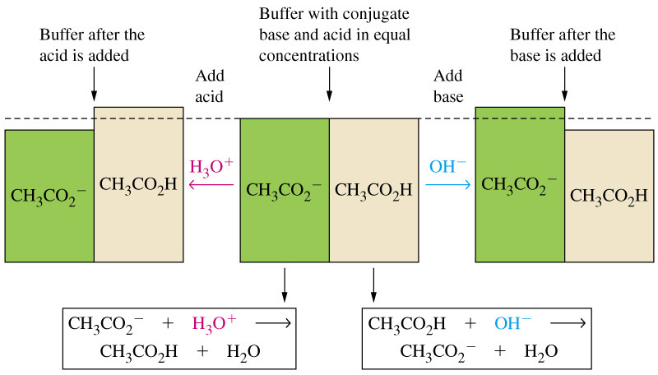
How A Buffer Works

Slide 16
The Henderson-Hasselbalch Equation
A variation of the ionization constant expression.
Consider a hypothetical weak acid, HA, and its salt NaA:
[H₃O⁺] [A⁻]
HA + H₂O  A⁻ + H₃O⁺
K_{a}=
[HA]
[A⁻]
[A⁻]
K_{a}=
[H₃O⁺]
-logK_{a}=
-log[H₃O⁺]-log
[HA]
[HA]

Slide 17
Henderson-Hasselbalch Equation
[A⁻]
-logK_{a}=
-log[H₃O⁺] - log
[HA]
[A⁻]
pK_{a} =
pH - log
[HA]
[A⁻]
pH =
pK_{a} + log
[HA]
[conjugate base]
pH =
pK_{a} + log
[acid]

Slide 18
Henderson-Hasselbalch Equation
[conjugate base]
pH=
pK_{a} + log
[acid]
Only useful when you can use initial concentrations of acid and salt.
  This limits the validity of the equation.
Limits can be met by:
[A⁻]
0.1 <
< 10
[HA]
[A⁻] > 10K_{a} and [HA] > 10K_{a}
Notes:
It is not practical to use [A⁻] = [HA] and select an appropriate acid. In practice you vary the buffer ratio to adjust the pH.

Slide 19
Example 18-5
Preparing a Buffer Solution of a Desired pH.
What mass of NaC₂H₃O₂ must be dissolved in 0.300 L of 0.25 M HC₂H₃O₂ to produce a solution with pH = 5.09? (Assume that the solution volume is constant at 0.300 L)
Equilibrium expression:
HC₂H₃O₂ + H₂O  C₂H₃O₂⁻ + H₃O⁺
[C₂H₃O₂⁻]
K_{a}=
[H₃O⁺]
= 1.810⁻⁵
[HC₂H₃O₂]

Slide 20
Example 18-5
[C₂H₃O₂⁻]
K_{a}=
[H₃O⁺]
= 1.810⁻⁵
[HC₂H₃O₂]
[H₃O⁺] = 10^{-5.09} = 8.110⁻⁶
[HC₂H₃O₂] = 0.25 M
Solve for [C₂H₃O₂⁻]
[HC₂H₃O₂]
0.25
[C₂H₃O₂⁻]
= K_{a}
= 1.810⁻⁵
= 0.56 M
[H₃O⁺]
8.110⁻⁶

Slide 21
Example 18-5
[C₂H₃O₂⁻] = 0.56 M
0.56 mol
1 mol NaC₂H₃O₂
mass C₂H₃O₂⁻ = 0.300 L


1 L
1 mol C₂H₃O₂⁻
82.0 g NaC₂H₃O₂

= 14 g NaC₂H₃O₂
1 mol NaC₂H₃O₂

Slide 22
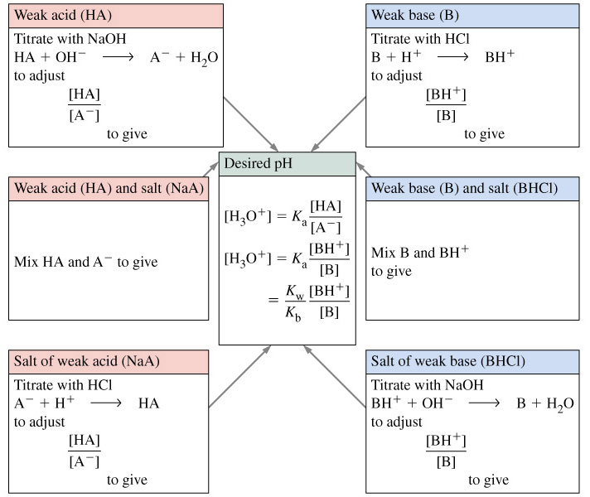
Six Methods of Preparing Buffer Solutions

Slide 23
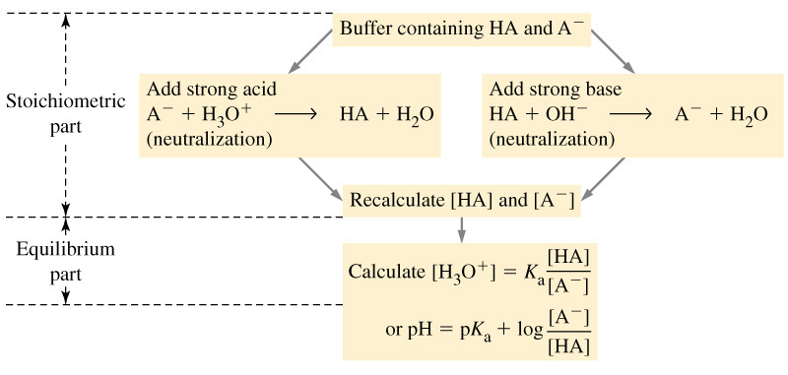
Calculating Changes in Buffer Solutions

Slide 24
Buffer Capacity and Range
Buffer capacity is the amount of acid or base that a buffer can neutralize before its pH changes appreciably.
  Maximum buffer capacity exists when [HA] and [A⁻] are large and approximately equal to each other.
Buffer range is the pH range over which a buffer effectively neutralizes added acids and bases.
  Practically, range is 2 pH units around pK_{a}

Slide 25
18-3 Acid-Base Indicators
Color of some substances depends on the pH.
HIn + H₂O  In⁻ + H₃O⁺
>90% acid form the color appears to be the acid color
>90% base form the color appears to be the base color
Intermediate color is seen in between these two states.
Complete color change occurs over 2 pH units.

Slide 26
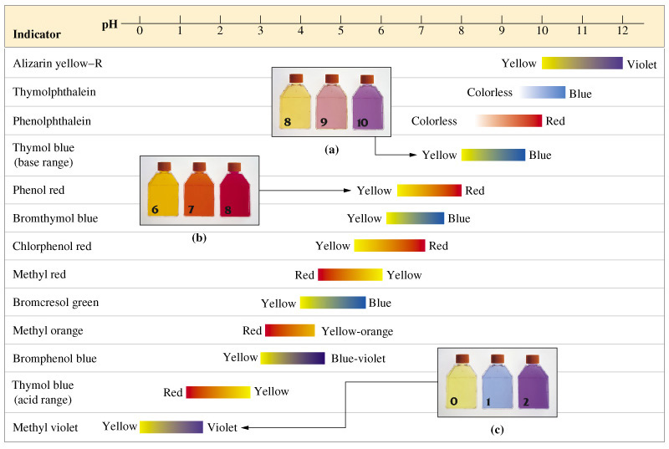
Indicator Colors and Ranges

Slide 27
18-4 Neutralization Reactions and Titration Curves
Equivalence point:
  The point in the reaction at which both acid and base have been consumed.
  Neither acid nor base is present in excess.
End point:
  The point at which the indicator changes color.
Titrant:
  The known solution added to the solution of unknown concentration.
Titration Curve:
  The plot of pH vs. volume.

Slide 28
The millimole
Typically:
  Volume of titrant added is less than 50 mL.
  Concentration of titrant is less than 1 mol/L.
  Titration uses less than 1/1000 mole of acid and base.
mol
mol/1000
mmol
M =
=
=
L
L/1000
mL

Slide 29
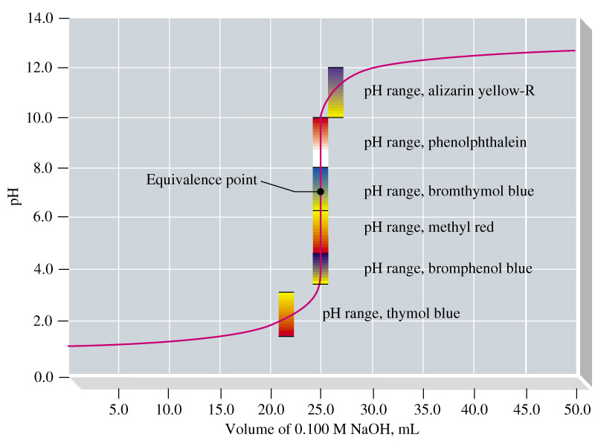
Titration of a Strong Acid with a Strong Base

Slide 30
Titration of a Strong Acid with a Strong Base
The pH has a low value at the beginning.
The pH changes slowly
  until just before the equivalence point.
The pH rises sharply
  perhaps 6 units per 0.1 mL addition of titrant.
The pH rises slowly again.
Any Acid-Base Indicator will do.
  As long as color change occurs between pH 4 and 10.

Slide 31
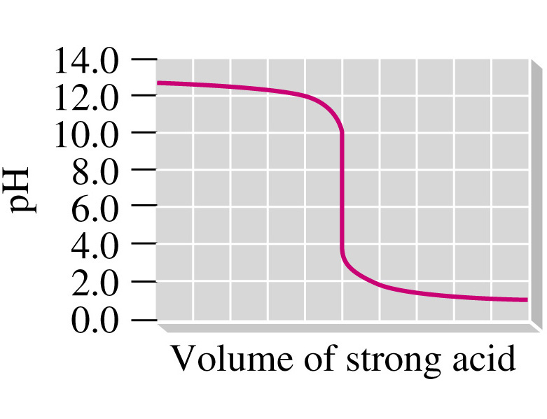
Titration of a Strong Base with a Strong Acid

Slide 32
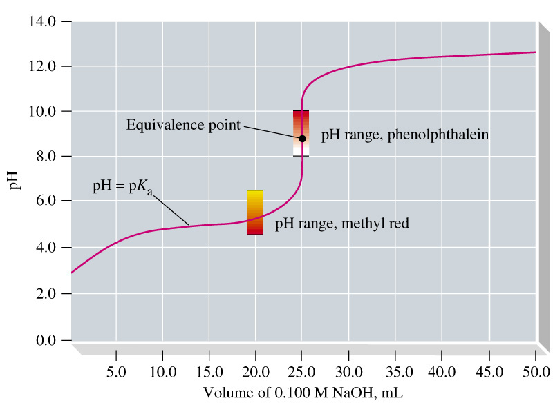
Titration of a Weak Acid with a Strong Base

Slide 33
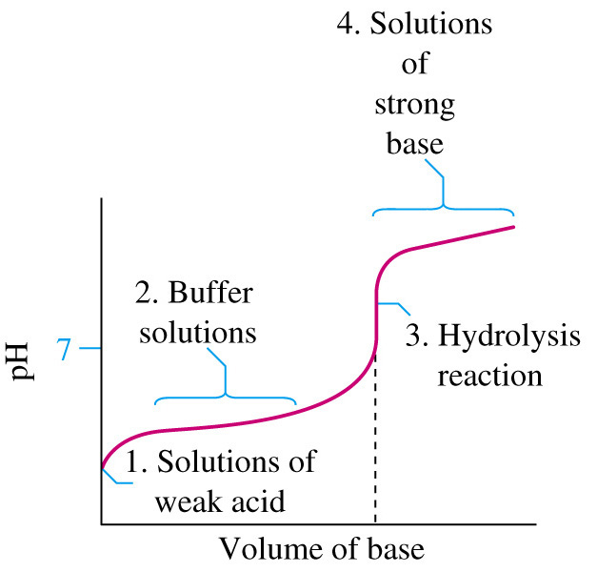
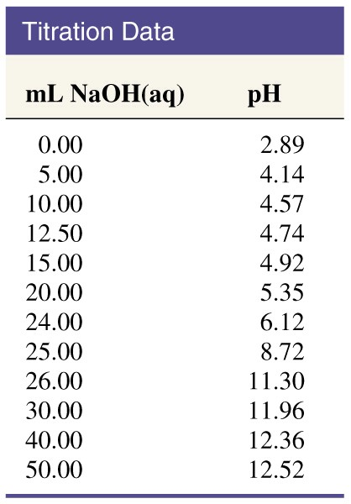
Titration of a Weak Acid with a Strong Base

Slide 34
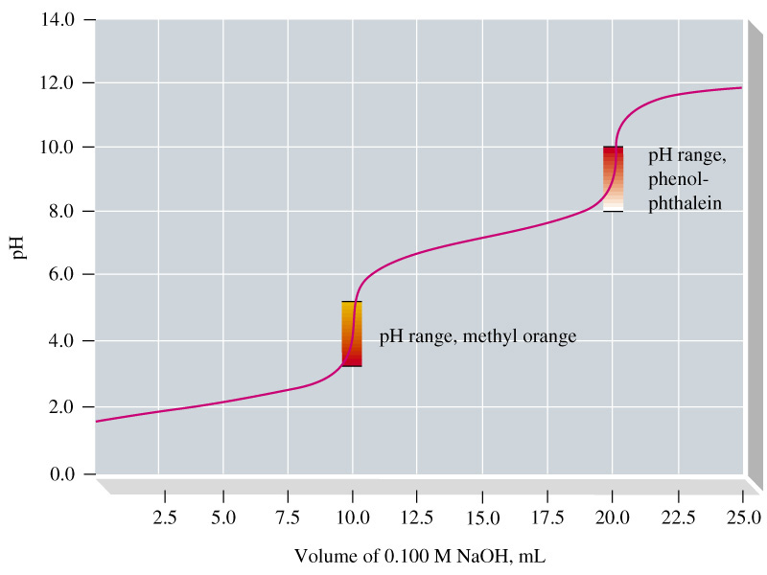
Titration of a Weak Polyprotic Acid
NaOH
NaOH
H₃PO₄  H₂PO₄⁻  HPO₄²⁻  PO₄³⁻

Slide 35
18-5 Solutions of Salts of Polyprotic Acids
The third equivalence point of phosphoric acid can only be reached in a strongly basic solution.
The pH of this third equivalence point is not difficult to caluclate.
  It corresponds to that of Na₃PO₄ (aq) and PO₄³⁻ can ionize only as a base.
PO₄³⁻ + H₂O → OH⁻ + HPO₄²⁻
K_{b} = K_{w}/K_{a} = 2.410⁻²

Slide 36
Example 18-9
Determining the pH of a Solution Containing the Anion (A^{n-}) of a Polyprotic Acid.
Sodium phosphate, Na₃PO₄, is an ingredient of some preparations used to clean painted walls before they are repainted. What is the pH of 1.0 M Na₃PO₄?
K_{b} = 2.410⁻² PO₄³⁻ + H₂O → OH⁻ + HPO₄²⁻
Initial concs. 1.0 M 0 M 0 M
Changes -x M +x M +x M
Eqlbrm conc. (1.00 - x) M x M x M

Slide 37
Example 18-9
[OH⁻] [HPO₄²⁻]
x · x
K_{b}=
=
= 2.410⁻²
[PO₄³⁻]
(1.00 - x)
x² + 0.024x – 0.024 = 0 x = 0.14 M
pOH = +0.85 pH = 13.15
It is more difficult to calculate the pH values of NaH₂PO₄ and Na₂HPO₄ because two equilibria must be considered simultaneously.

Slide 38
Concentrated Solutions of
Polyprotic Acids
For solutions that are reasonably concentrated
(> 0.1 M) the pH values prove to be independent of solution concentrations.
for H₂PO₄⁻
pH = 0.5 (pK_{a1} + pK_{a2}) = 0.5 (2.15 + 7.20) = 4.68
for HPO₄²⁻
pH = 0.5 (pK_{a1} + pK_{a2}) = 0.5 (7.20 + 12.38) = 9.79

Slide 39
18-6 Acid-Base Equilibrium Calculations:
A Summary
Determine which species are potentially present in solution, and how large their concentrations are likely to be.
Identify possible reactions between components and determine their stoichiometry.
Identify which equilibrium equations apply to the particular situation and which are most significant.

Slide 40
Focus On Buffers in Blood
CO₂(g) + H₂O  H₂CO₃(aq)
H₂CO₃(aq) + H₂O(l)  HCO₃⁻(aq)
K_{a1} = 4.410⁻⁷ pK_{a1} = 6.4
pH = 7.4 = 6.4 +1.0
[HCO₃⁻]
pH = pK_{a1} + log
[H₂CO₃]

Slide 41
Buffers in Blood
10/1 buffer ratio is somewhat outside maximum buffer capacity range but…
    The need to neutralize excess acid (lactic) is generally greater than the need to neutralize excess base.
    If additional H₂CO₃ is needed CO₂ from the lungs can be utilized.
    Other components of the blood (proteins and phosphates) contribute to maintaining blood pH.

Slide 42
Chapter 18 Questions
Develop problem solving skills and base your strategy not on solutions to specific problems but on understanding.
Choose a variety of problems from the text as examples.
Practice good techniques and get coaching from people who have been here before.

